Slide 1
Budget Wise AI Based Expense Forecasting Tool

Slide 2
Introduction
AI-driven financial management application
Helps users understand, manage, and predict expenses effectively
Automatically categorizes financial transactions
Analyzes spending patterns and trends
Uses Prophet time-series forecasting to predict future expenses
Provides visualizations for spending insights and budget tracking
Enables users to set achievable financial goals
Enhances financial awareness and decision-making
Supports long-term financial planning and stability

Slide 3
System Workflow Overview
This system follows a data-driven workflow that starts from the user entering financial data and ends with AI-powered forecasts and insights:
User Interaction Layer
Users register & log in securely.
Inputs or uploads transaction data.
Sets financial or savings goals.
Views dashboards, reports, and forecasts.
Web UI Layer
Built using Streamlit / Flask / Dash.
Provides responsive pages for:
Login & registration
Manual transaction entry
Spending reports
Forecast visualization
Ensures smooth user experience with interactive charts.

Slide 4
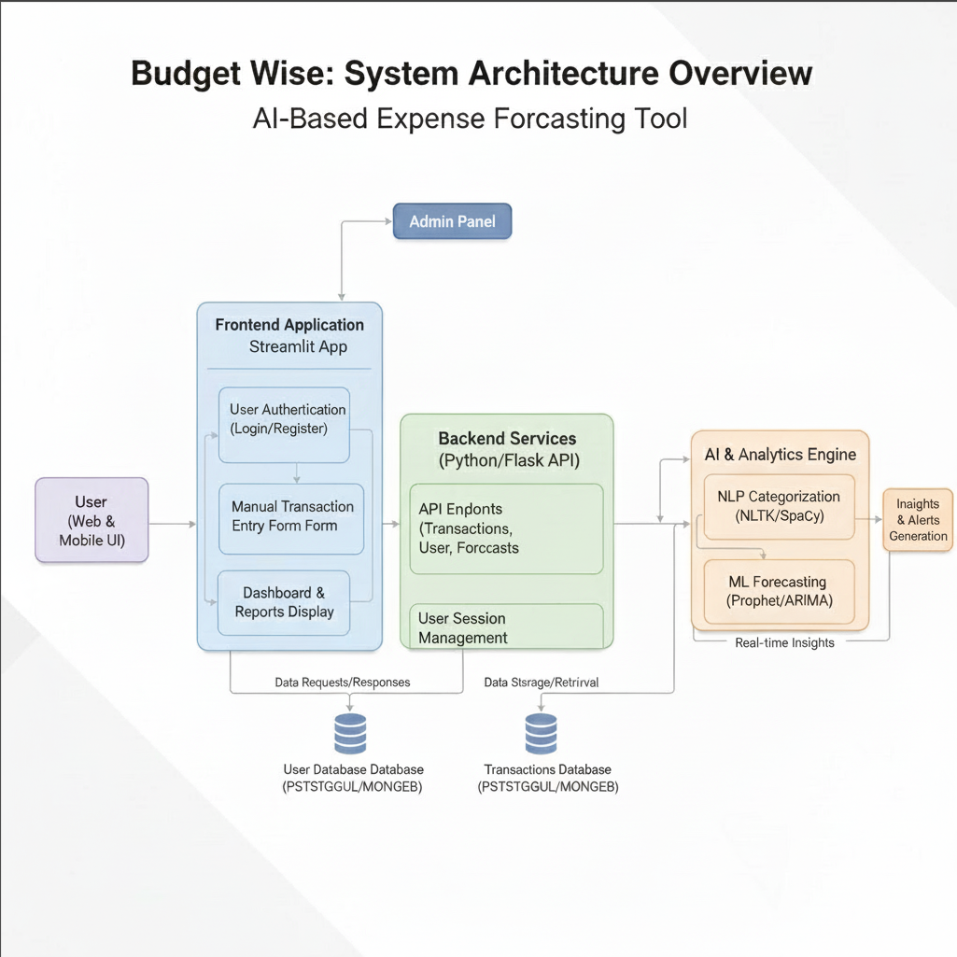

Slide 5
Backend Application Layer
Handles authentication sessions using JWT.
Performs request routing, API processing, and validation.
Communicates with the databases for CRUD operations.
Prepares transaction data for analytics and ML models.
Categorization Engine (Rules / NLTK NLP)
Takes raw transaction descriptions (e.g., “Uber ride”, “Metro ticket”).
Applies keyword-based rules or small NLP models.
Automatically categorizes into groups:
Groceries
Travel
Food & Dining
Utilities
Rent
Entertainment
Supports manual overrides for accuracy.

Slide 6
Data Analysis Layer (Pandas/NumPy)
Cleans and prepares time-series financial data.
Calculates monthly, weekly, and category-wise summaries.
Generates insights such as:
Top spending categories
Monthly trends
Cashflow balance
Overspending alerts
.
Databases
User DB: personal & login details
Transaction DB: all income/expense records
Category DB: category labels & rules
Goals DB: savings goals and progress status

Slide 7
Forecasting Layer (Prophet)
Converts expense history into a time-series dataset.
Predicts future expenses for:
Each category
Total spending
Monthly cashflow
Detects seasonal patterns (month-end peaks, festival spikes).
Outputs next-month and next-quarter forecasts.
Admin Panel
Allows system administrators to:
Manage category rules
Correct misclassified transactions
Monitor system logs and user statistics
Ensures scalability and data integrity.

Slide 8
Detailed System Components
Frontend (UI Layer)
Built using Streamlit / Dash (interactive UI framework).
Includes:
Login interface
Dashboard home
Transaction entry pages
Forecast visualization screens
Category-wise spending charts
Backend Layer
Built using Flask / FastAPI, acting as the:
Controller for user requests
Authentication gateway
Business logic handler

Slide 9
Categorization Engine
Uses:
Regex-based keyword extraction
NLTK tokenization
Predefined mapping dictionaries
Automatically assigns categories based on patterns:
“petrol”, “uber”, “metro” → Transport
“milk”, “vegetables” → Groceries
Databases
Implemented using SQLite / PostgreSQL.
Tables include:
Users
Transactions
Categories
Goals
Admin logs

Slide 10
Analytics Engine
Performs:
Aggregations with Pandas
Cashflow analysis
Category grouping
Monthly spending trends
Year-over-year comparisons
Forecasting Engine (Prophet)
Learns:
Seasonality
Trend patterns
Cycles
Generates:
30-day forecast
Multi-month projection
Confidence intervals

Slide 11
Packages Used
Core Backend Packages
Package | Purpose
Flask / FastAPI | Backend routing, APIs
Streamlit | UI and dashboards
SQLAlchemy | ORM for DB operations
PyJWT | Authentication with tokens
Werkzeug | Password hashing

Slide 12
Data & Analytics Packages
Package | Purpose
Pandas | Data manipulation and summary reports
NumPy | Numerical operations
Matplotlib | Static charts
Seaborn | Trend visualizations
Plotly | Interactive charts
NLP / Categorization
Package | Purpose
NLTK | Basic natural language processing
Regex | Keyword-based rules

Slide 13
Forecasting & Machine Learning
Package | Purpose
Prophet | Time-series expense forecasting
Scikit-learn | Scaling, preprocessing

Slide 14
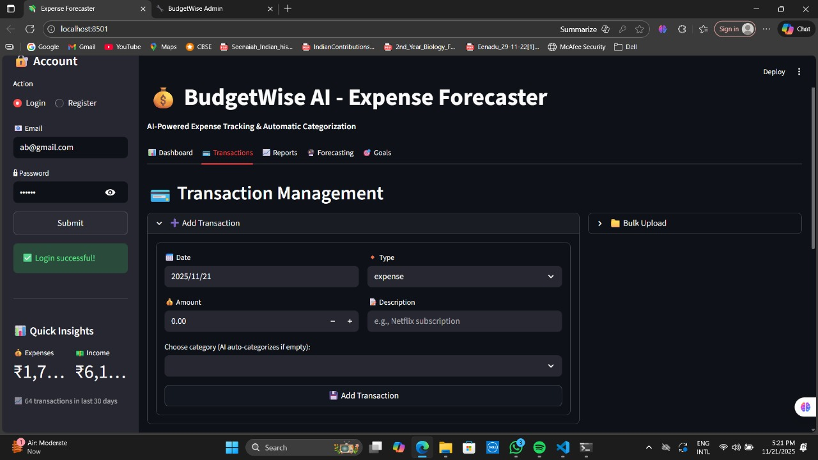
Milestone 1
Milestone 1: User Authentication & Transaction Input (Weeks 1–2)
What Was Developed
✔ User Authentication
Registration page for new users
Secure login system using JWT-based authentication
Password hashing using Werkzeug
Profile management page
✔ Transaction Input Module
Users can manually enter:
Transaction date
Amount
Description
Type: Income or Expense
Optional category selection
Input validation to avoid errors

Slide 15
Technical Stack Used
Flask / Streamlit
SQLAlchemy for DB
PyJWT for security
Pandas for temporary data storage
Deliverables
Login & signup screens
Basic user dashboard
Transaction input form

Slide 16
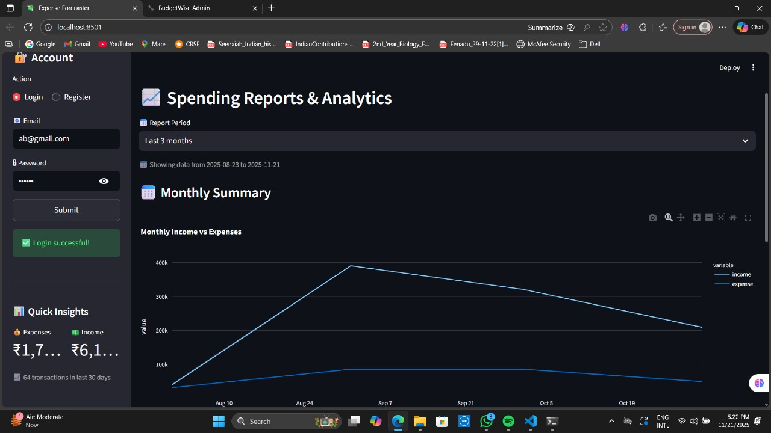
Milestone 2
Milestone 2: Categorization & Reporting (Weeks 3–4)
What Was Developed
✔ Rule-based Categorization
Keyword dictionary:
“bus”, “uber” → Transport
“electricity”, “water bill” → Utilities
NLTK for tokenizing and filtering description text
Auto assigns categories → reduces manual work
✔ Reporting Module
Monthly spending summary
Category-wise breakdown
Income vs Expense comparison
Visualization charts:
Bar charts (Top categories)
Pie charts (Spending distribution)
Line charts (Trend analysis)

Slide 17
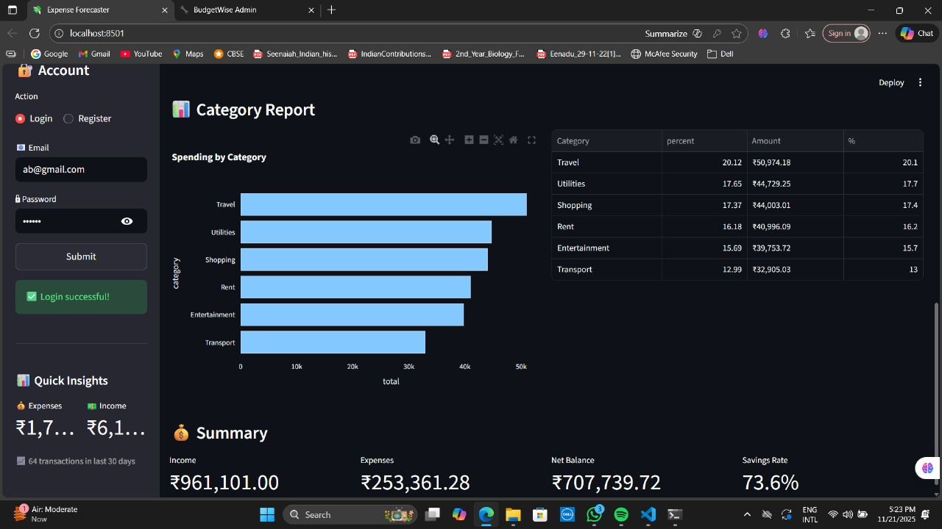
Technical Stack Used
Pandas (aggregation)
NLTK (NLP)
Matplotlib (visuals)
Seaborn (trend lines)
Deliverables
Initial dashboard layout
Automated categorization engine
Category-wise reports

Slide 18
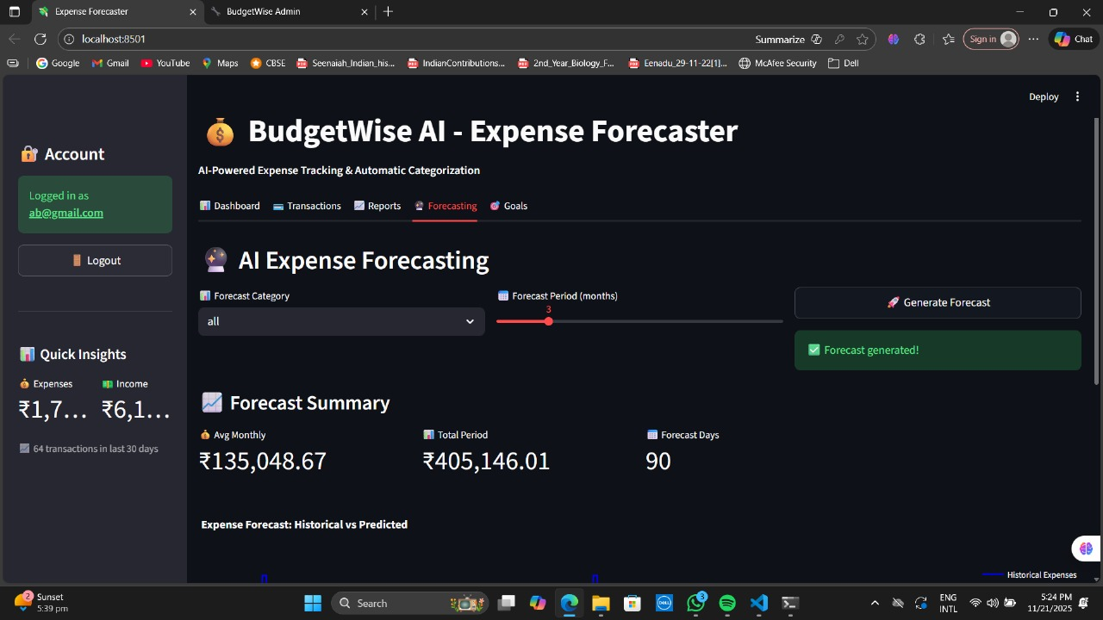
Milestone 3
Milestone 3: Forecasting & Goal Setting (Weeks 5–6)
What Was Developed
✔ Data Preparation for ML
Converted raw transactions into monthly aggregated time series
Filled missing months
Added features like:
Month
Seasonality
Category-level sequences
✔ Prophet Forecasting Integration
Built forecasting models for:
Total expenses
Individual categories
Visualized:
Future 30–90 day predictions
Upper/lower confidence intervals

Slide 19
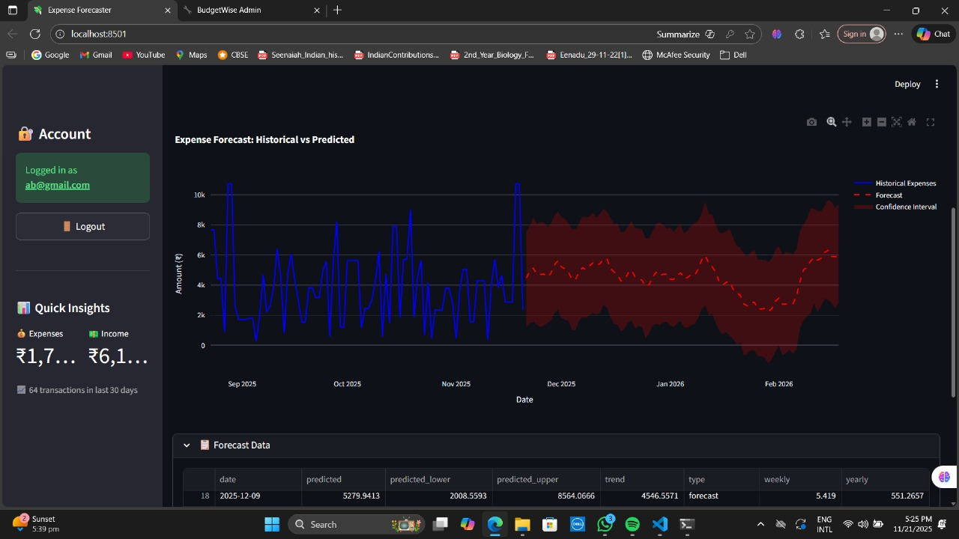
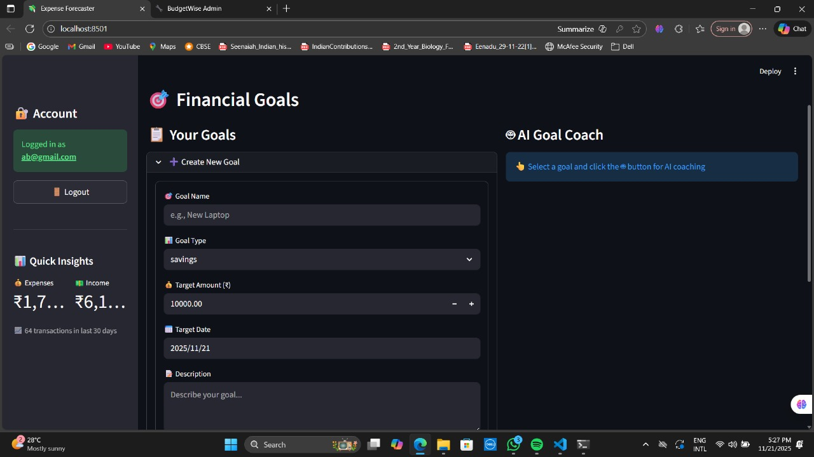
✔ Goal Setting Module
Users can set:
Savings targets
Monthly spending limits
“Reduce category spend by X%” rules
Tracks percentage of goal completion
Alerts users when they are off track
Technical Stack Used
Prophet
Pandas
Matplotlib/Seaborn
Deliverables
Forecast graphs (actual vs predicted)
Goal creation interface
Goal progress tracking

Slide 20
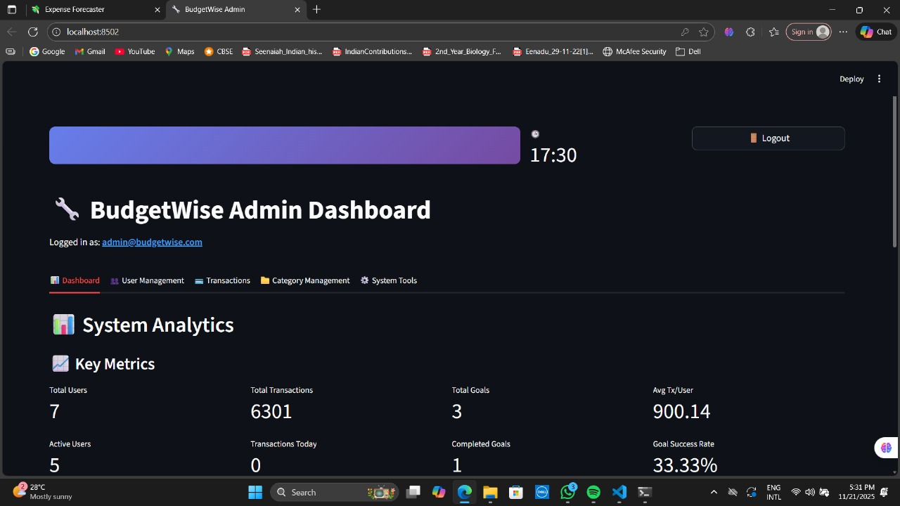
Milestone 4
Milestone 4: Dashboarding, Admin Panel & Deployment (Weeks 7–8)
What Was Developed
✔ Interactive Dashboard
Built using Streamlit / Dash
Includes:
Real-time expense charts
Category filters
Forecast overlays
Top spending category tables
Goal progress visualization
✔ Admin Panel
Category management
Add/update/delete rules
View users and transaction stats

Slide 21
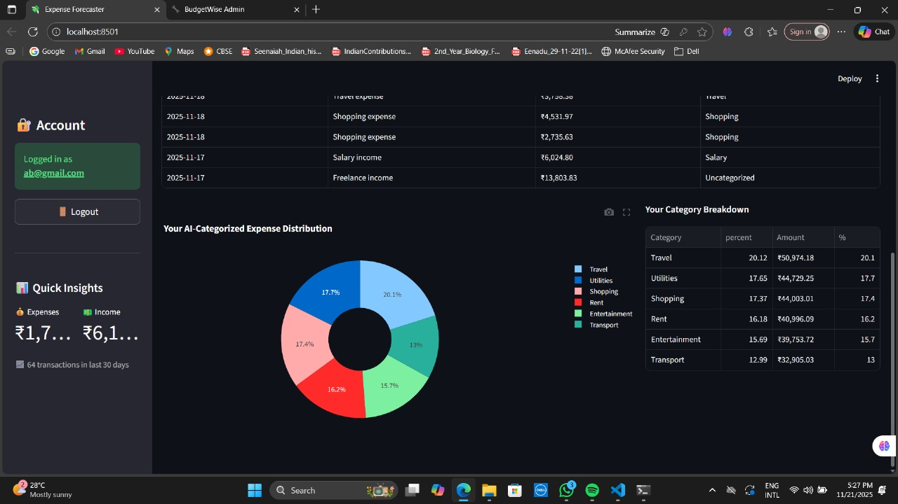
✔ Deployment Preparation
Complete app packaged into Docker container
Environment variables for secrets
Database connection handled securely
Technical Stack Used
Streamlit / Dash
Plotly
Docker
SQLAlchemy
Deliverables
Fully functioning dashboard
Admin management tools
Dockerized application

Slide 22
Workflow Description
This workflow demonstrates how the Personal Budgeting & Forecasting system processes financial transactions from input to AI-driven forecasts.
User Layer
Inputs data
Sets goals
Views insights
Frontend Layer
Collects input via forms
Renders reports and charts
Backend Layer
Authenticates users
Validates input
Sends data to analysis & ML modules
Categorization Engine
Converts descriptions → categories through NLP/rules

Slide 23
Databases
Stores all user and financial data securely
Analysis Layer
Summaries
Monthly trends
Overspending alerts
Forecasting Layer
Time-series models
Predicts future expenses
Admin Layer
Category management

Slide 24
Conclusion
The Personal Budgeting & Expense Forecaster is a complete end-to-end financial analytics system. It integrates dashboards, NLP-based categorization, financial forecasting, and goal management into a single user-friendly platform.
This project demonstrates:
Full-stack development
Machine learning (Prophet forecasting)
NLP categorization
Data engineering
Visualization
Deployment
Authentication & admin management

Slide 25
Thank You

